Slide 1

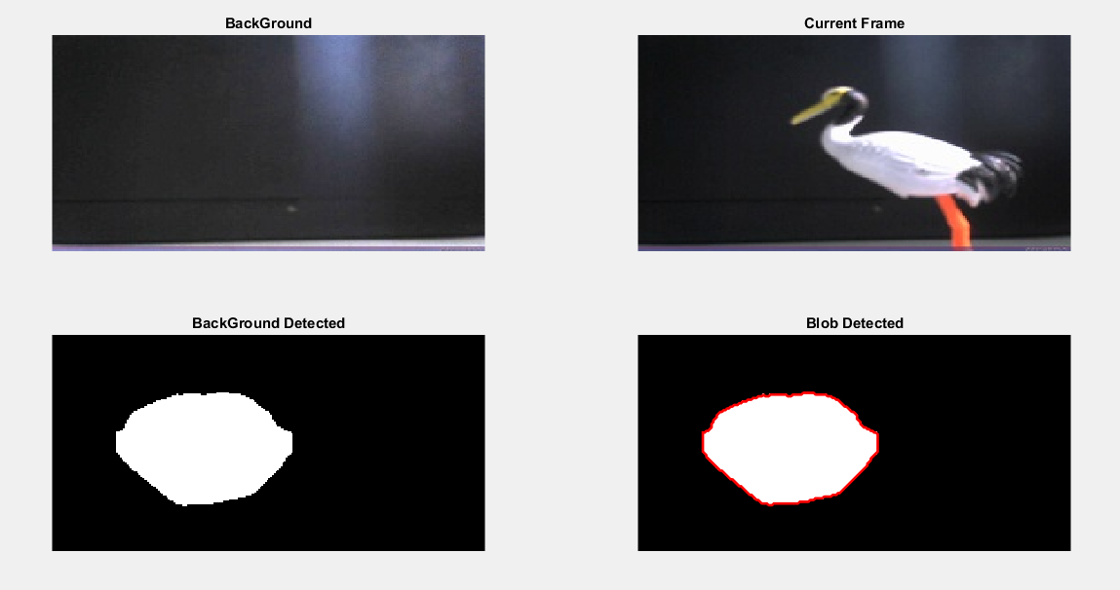
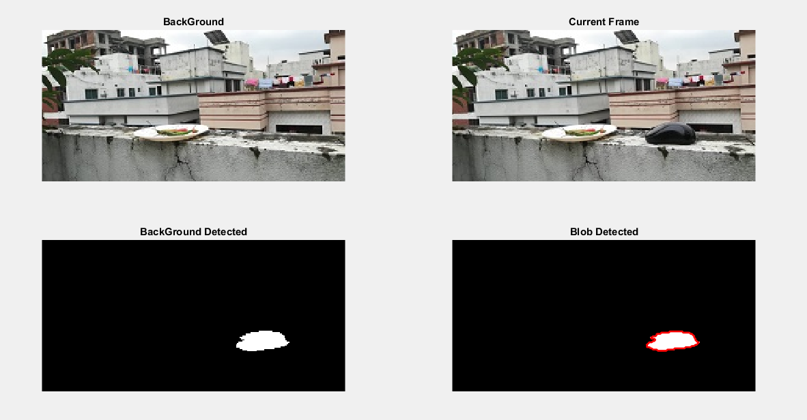
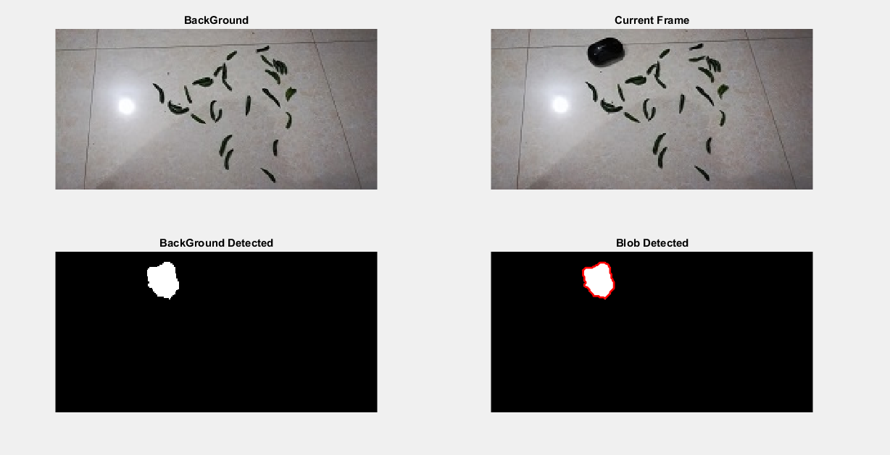
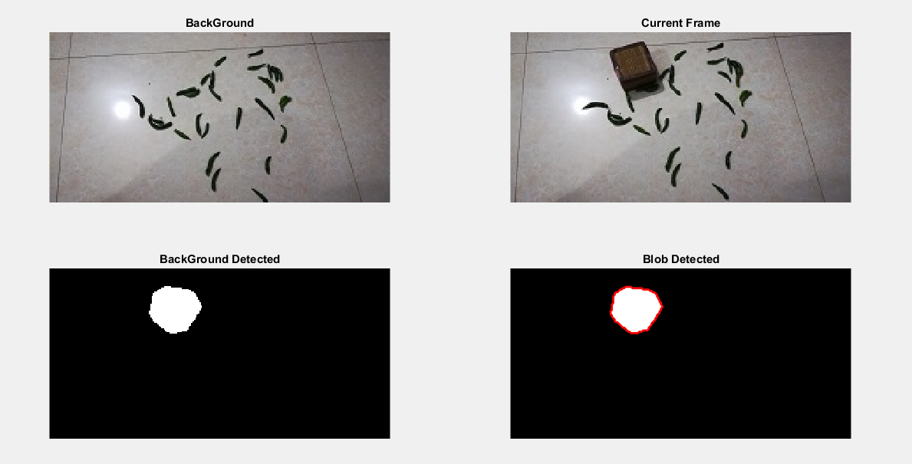
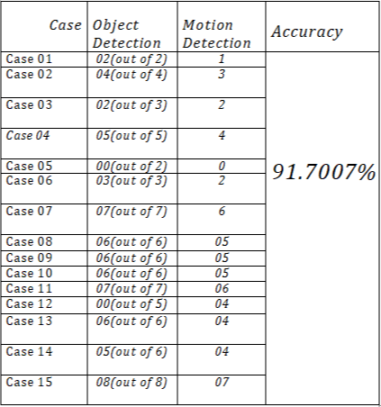
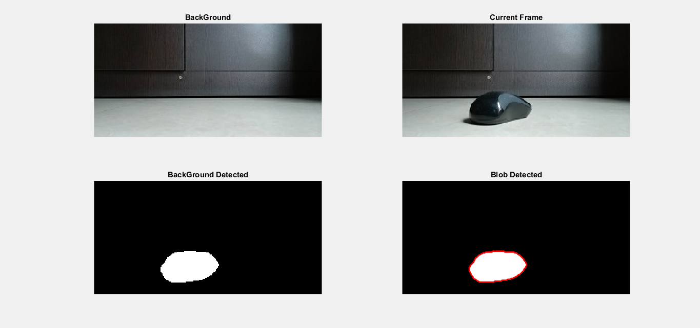
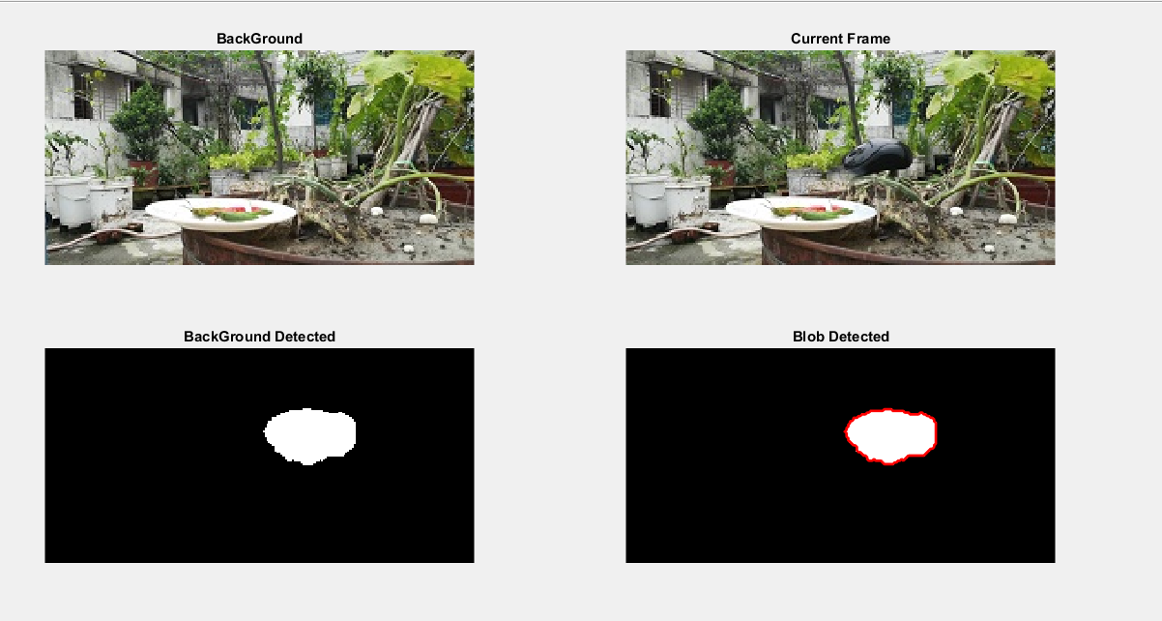
An Image processing based digital scarecrow
Dip Ghosh
Supervisor: Dr. Tanzilur Rahman
Department of Electrical and computer Engineering, North South University, Bangladesh
Abstract
Image detection by image processing approach
Flow Diagram
Orchard fruits and vegetable crops are vulnerable to wild birds and animals. These wild birds and animals can cause critical damage to the produce. Traditional methods of scaring away birds such as scarecrows are one of the solutions. Image processing methods can be effectively applied to detecting items with motion detection in video footage or taking snaps. The proposed system has been simulated in MATLAB software.
Start
Capture image
Background = Img1
Curr_frame = Img2
Is object detect
Yes
Capture Image
No
Image1 =Img2
Image2 =Img3
Capture Image
Objectives
Background = Img1
Curr_frame = Img2
Is motion detect
Yes
The system is able to detect and track the pest birds from the real time video frame and from images.
After the object is detected an alarm will raise as notification.
The system can detect the bird with motion.
The approach can implement in agricultural sector.
No
.
Result
Graph Representation

